Slide 1
I. Good point in compare with old system

Slide 2
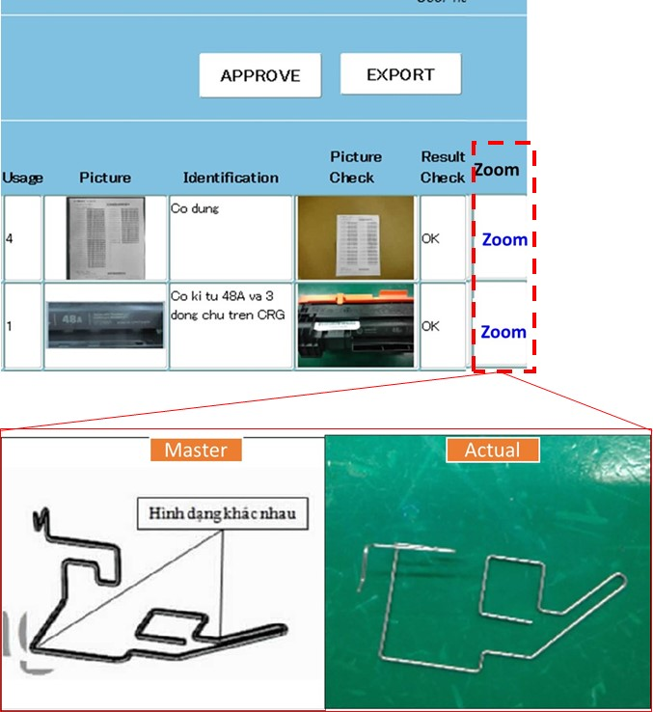
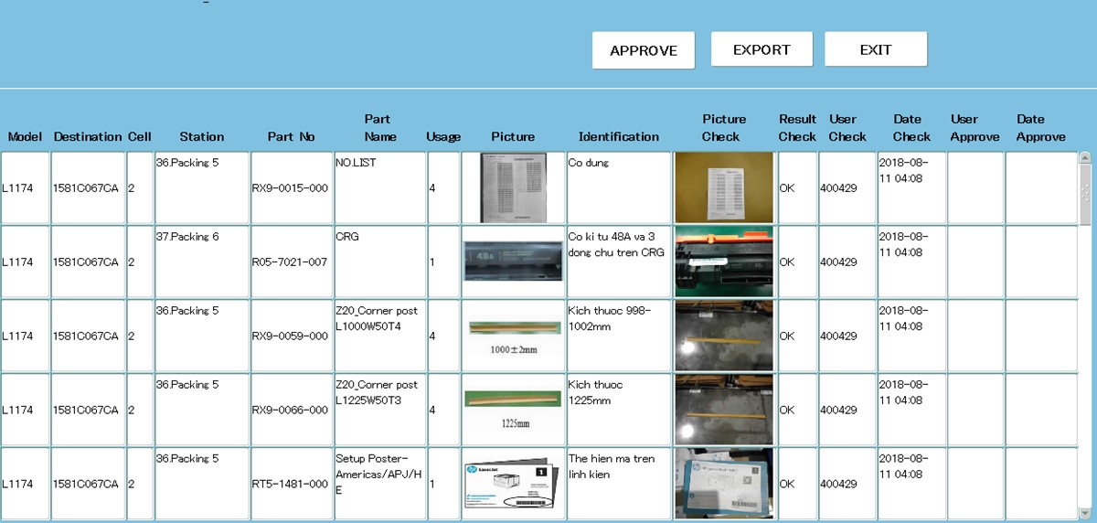
Improve at approval function & inquiry function (FM request)
➔ can zoom in picture
Current: Difficult to see
Improve idea:
Can Zoom in picture
Status: New system can zoom easily

Slide 3
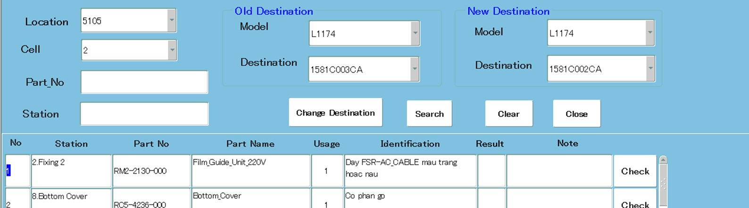
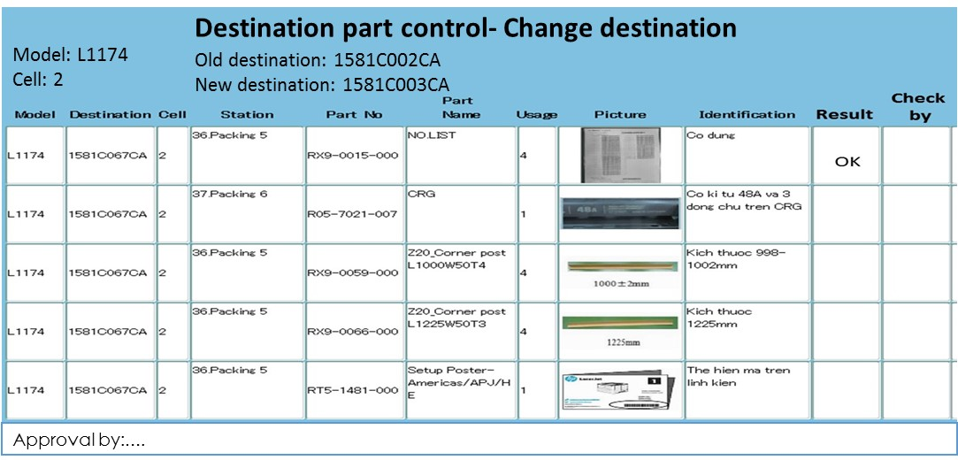
2. Export file to paper
Export
Status: If the speed is high ➔ no need export to paper: actually the speed is quick ➔ We’ll continue testing

Slide 4
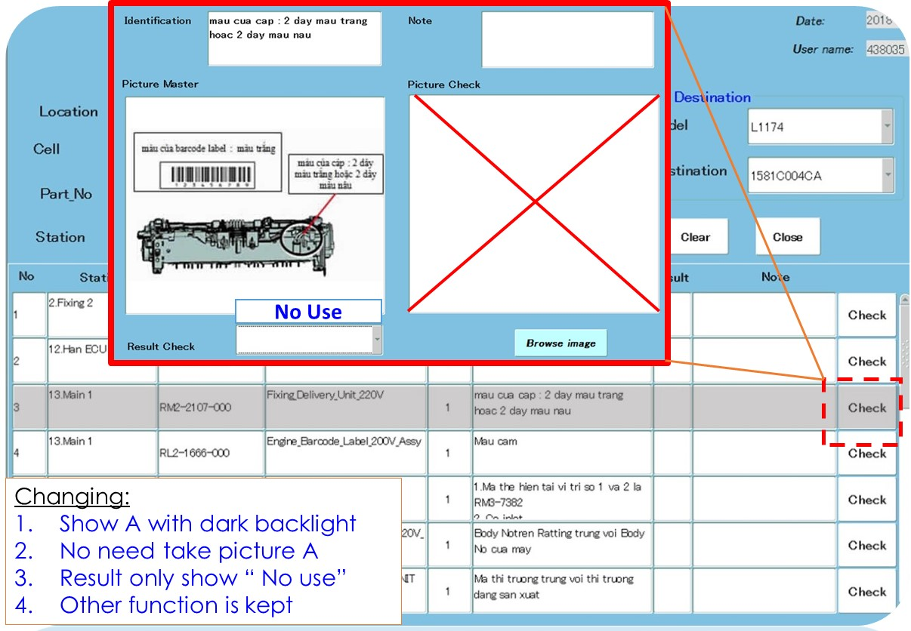
3. Change showing method
Change A➔B
A | B | Show
O | O | X
O | X | X
X | B | B
A | B | Show
O | O | X
O | X | A (dark backlight)
X | B | B
Risk: Assemble exceed part
Check: No use A for destination B
Status: already change
New system improve so much

Slide 5
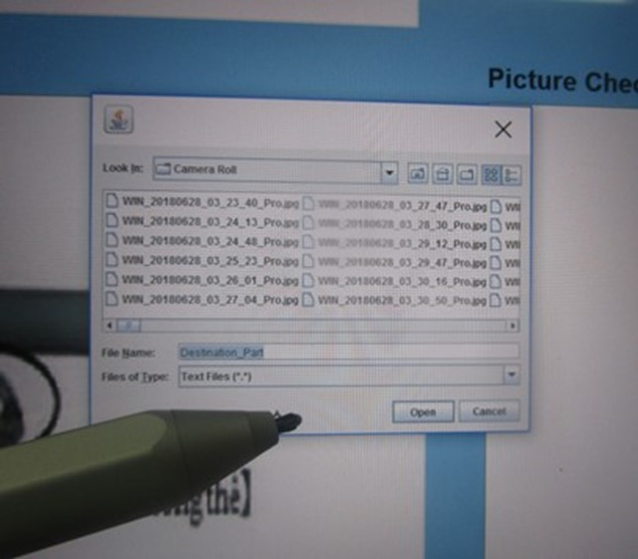
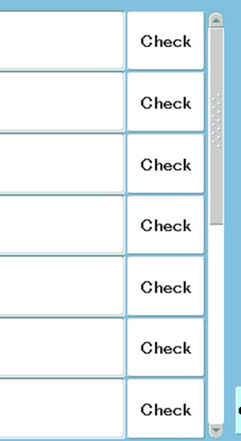
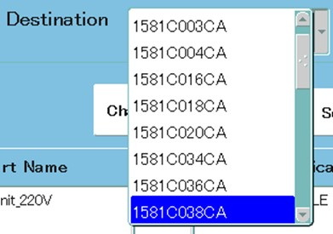
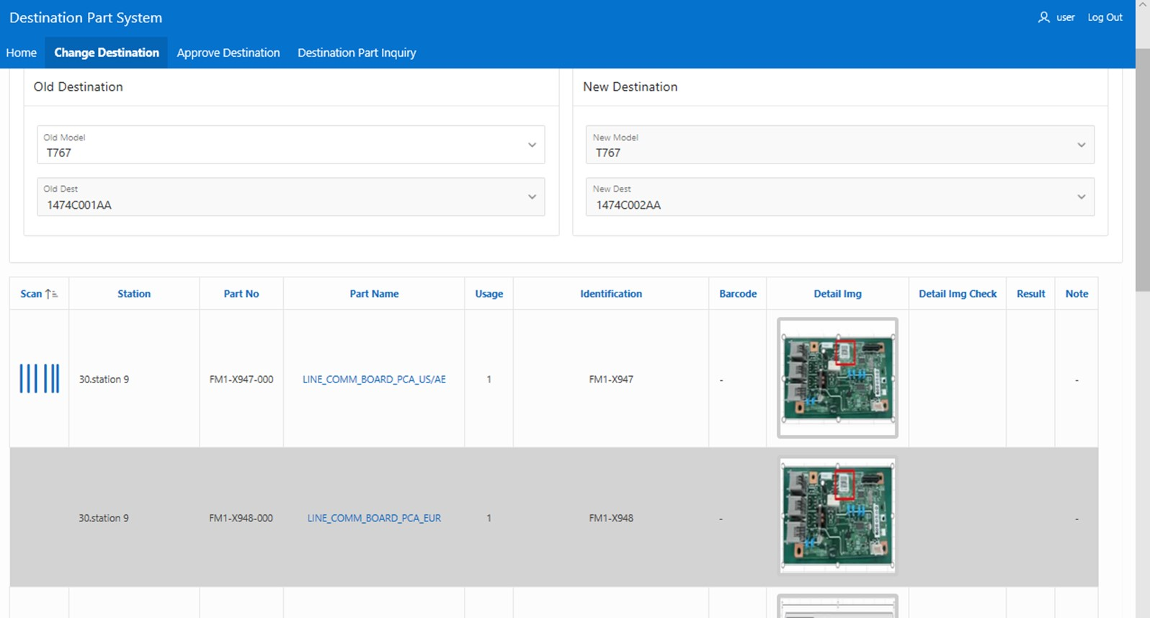
4. Improve side of Scroll tool & Attention notice
Current: Small size ➔ difficult to use.
Status: from new version: can scroll easily
New system improve so much

Slide 6
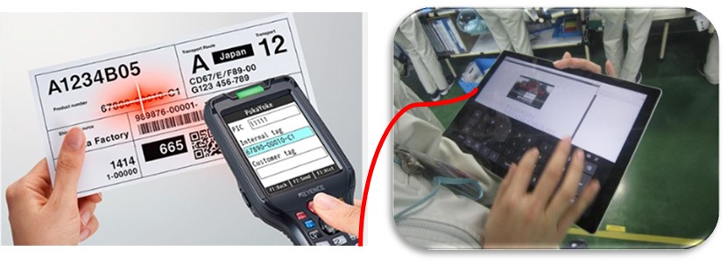

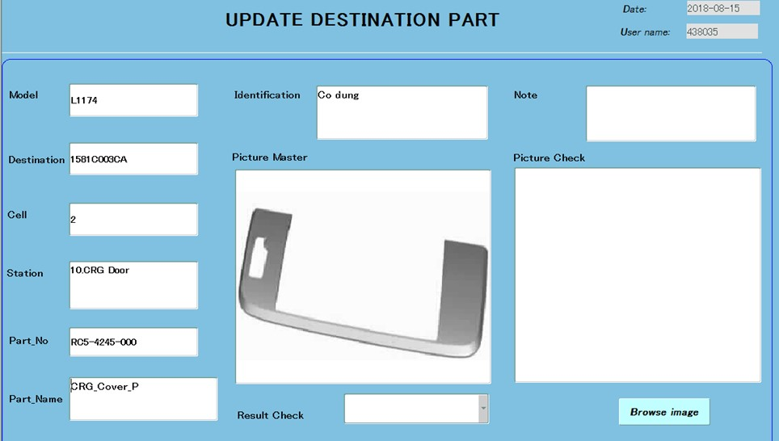
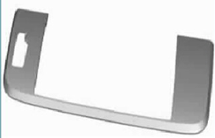
2. Input barcode/character & Auto judgment result
Master
Scan & auto judgment
Picture
IIIIIIIIIIIIIIIIIIIIIII
123456845
Barcode
RC5-4245
Character
Auto judgment
Improve input equipment and auto judgment by system
New system can input barcode

Slide 7
There are some kind of barcode master
1. Fix length & Fix character
Dest | Destination part | Barcode master (10 characters)
1581C003ca 1581C018CA 1581C042CA …. | RM2-2110-000 | 1254237655
2. Fix length and barcode is within 1 range
Dest | Destination part | Barcode master (10 characters)
1581C001ca 1581C002CA | RK3-3506-000 | B1******** (******** from 00000000~99999999)
3. Fix length and some barcode available also.
Dest | Destination part | Barcode master (10 characters)
1581C008ca 1581C009CA | RK3-3506-000 | B1******** C1******** D1******** (******** from 00000000~99999999)
New system can input barcode

Slide 8
Reduce checking time by improve at new system
1.
Old system: Need take picture and browse
New: auto link picture
2.
Old: side of Scroll tool & Attention notice Is small ➔ effect to operation
New: easy to scroll
➔ reduce checking time

Slide 9
I. Need improve point

Slide 10
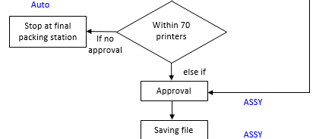
Stop line if no approval (within 1 pallet q’ty)
➔ When finish modify remain item page 3/4/5 ➔ MFE connect result to final packing (PIC-Lich/Nghiem MFE)
Test tablet system smoothly then apply function stop line if no approval (MFE)

Slide 11
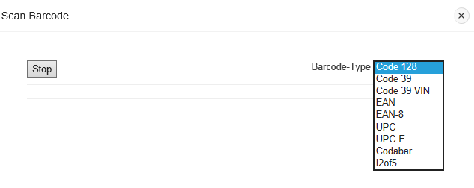
1. Can auto read barcode without any select type operation

Slide 12
2. Can scan QR code

Slide 13
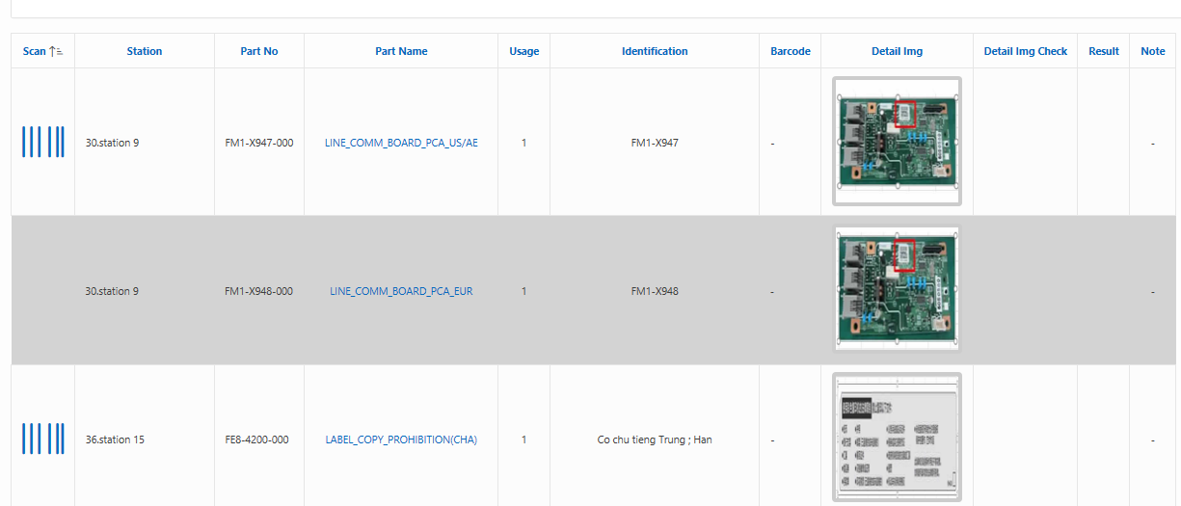
3. Some dark area : need confirm “already check”
Purpose: prevent skipping operation

Slide 14
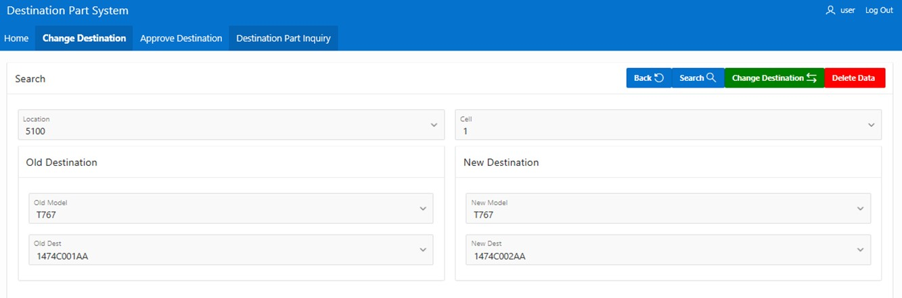
Search part
4. Add function search part

